Slide 1
A multi-dimensional data model
ITE-404 - Data Warehousing and Data Mining

Slide 2
Dimensional Modeling
Data warehouses and OLAP tools are based on a multidimensional data model.
This model views data in the form of a data cube
“What is a data cube?” A data cube allows data to be modeled and viewed in multiple dimensions. It is defined by dimensions and facts. Useful in decision support systems and mining
Dimension: dimensions are the perspectives or entities with respect to which an organization wants to keep records i.e, collection of logically related attributes; axis for modeling data.
Facts: data stored
Ex: Dimensions – products, locations, date
Facts – quantity, unit price
DM: May view data as dimensional.
ITE-404 - Data Warehousing and Data Mining

Slide 3
Dimensions and Facts
Each dimension may have a table associated with it, called a dimension table, which further describes the dimension. For example, a dimension table for item .
A multidimensional data model is typically organized around a central theme, like sales, for instance. This theme is represented by a fact table.
Facts are numerical measures. Think of the measure the quantities by which we want to analyze relationships between dimensions.
Examples of facts for a sales data warehouse include dollars sold (sales amount in dollars), units sold (number of units sold), and amount budgeted.
The fact table contains the names of the facts, or measures, as well as keys to each of the related dimension tables.
ITE-404 - Data Warehousing and Data Mining

Slide 4
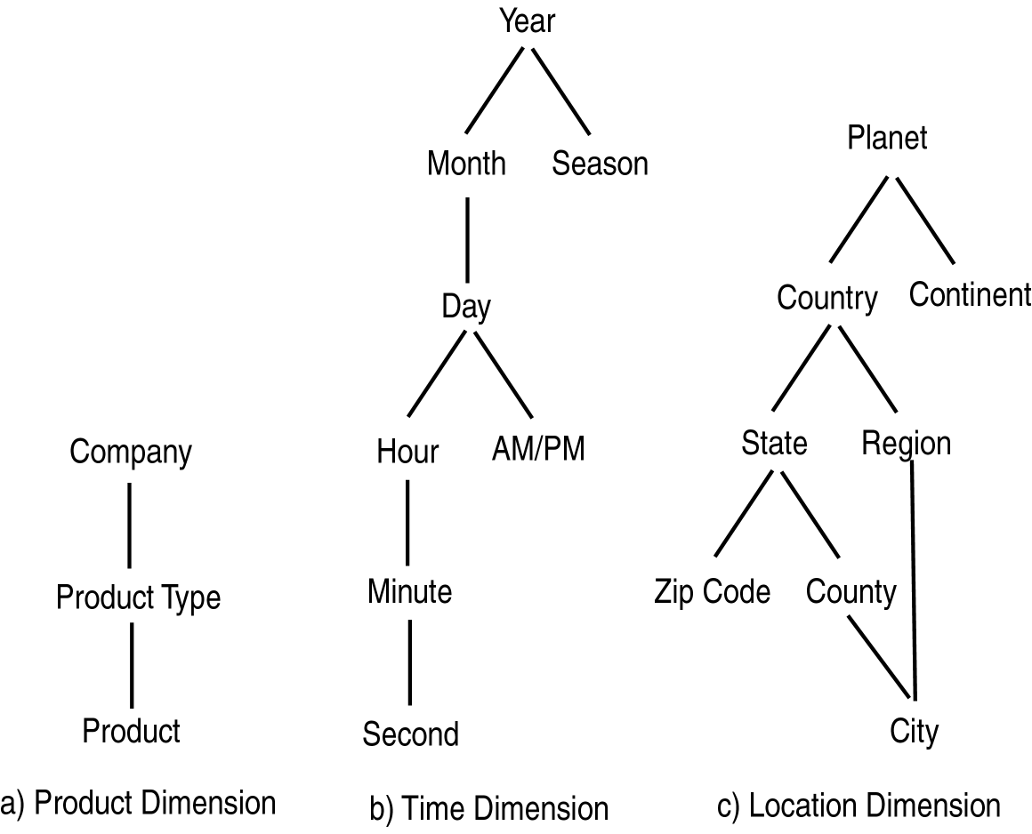
ITE-404 - Data Warehousing and Data Mining

Slide 5
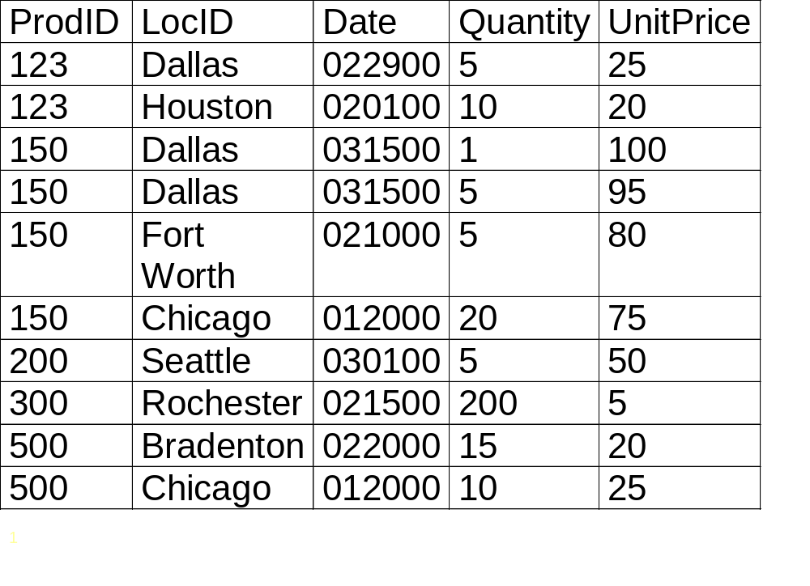
Relational View of Data
ITE-404 - Data Warehousing and Data Mining

Slide 6
Dimensional Modeling Queries
Roll Up: more general dimension
Drill Down: more specific dimension
Dimension (Aggregation) Hierarchy
SQL uses aggregation
Decision Support Systems (DSS): Computer systems and tools to assist managers in making decisions and solving problems.
ITE-404 - Data Warehousing and Data Mining

Slide 7
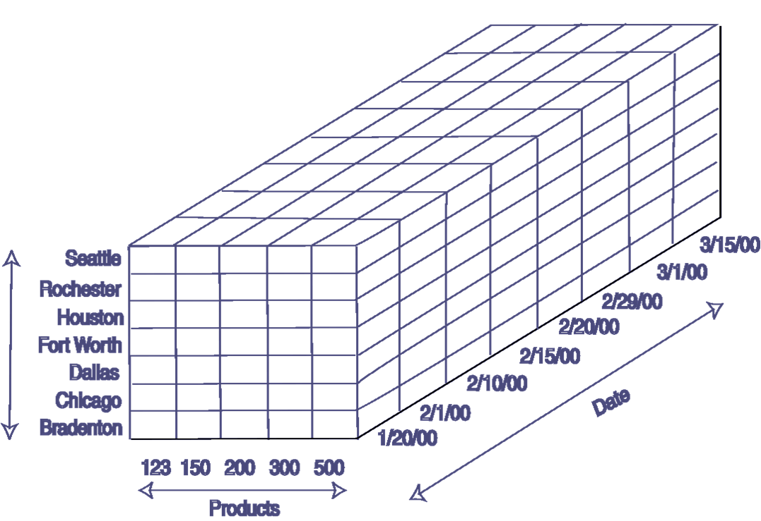
Cube view of Data
ITE-404 - Data Warehousing and Data Mining

Slide 8
Data cube (3D)
A data cube, such as sales, allows data to be modeled and viewed in multiple dimensions
Suppose ALLELETRONICS create a sales data warehouse with respect to dimensions
  Time
  Item
  Location
ITE-404 - Data Warehousing and Data Mining

Slide 9
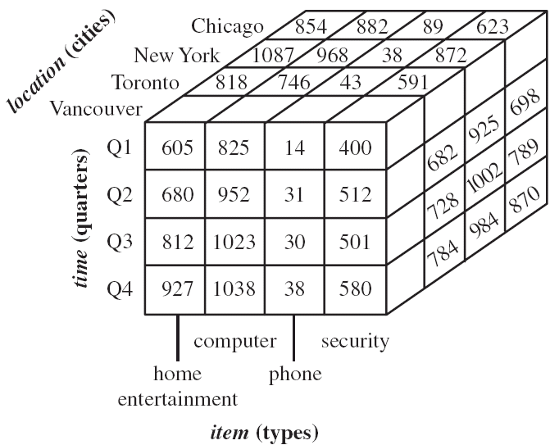
3D Data cube Example
ITE-404 - Data Warehousing and Data Mining

Slide 10
Data cube (4D)
A data cube, such as sales, allows data to be modeled and viewed in multiple dimensions
Suppose ALLELETRONICS create a sales data warehouse with respect to dimensions
  Time
  Item
  Location
  Supplier
ITE-404 - Data Warehousing and Data Mining

Slide 11
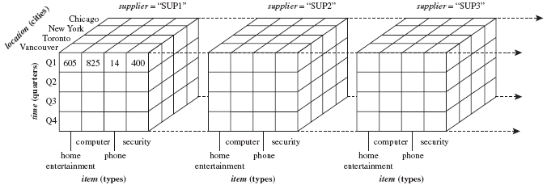
4D Data cube Example

Slide 12
Practice Question
What is a 5D cube looks like?
We can think of a 4-D cube as being a series of 3-D cubes.
If we continue in this way, we may display any n-D data as a series of (n-1)-D “cubes.”
The data cube is a metaphor for multidimensional data storage.
The actual physical storage of such data may differ from its logical representation.
The important thing to remember is that data cubes are n-dimensional and do not confine data to 3-D.
ITE-404 - Data Warehousing and Data Mining

Slide 13
Aggregation Hierarchies
ITE-404 - Data Warehousing and Data Mining

Slide 14
A Concept Hierarchy
defines a sequence of mappings from a set of low-level concepts to higher-level, more general concepts.
Consider a concept hierarchy for the dimension
location.
ITE-404 - Data Warehousing and Data Mining

Slide 15
A Concept Hierarchy: Dimension (location)
all
all
region
Europe
...
North_America
country
Germany
...
Spain
Canada
...
Mexico
city
Frankfurt
...
Vancouver
...
Toronto
office
L. Chan
...
M. Wind
ITE-404 - Data Warehousing and Data Mining

Slide 16


View of Warehouses and Hierarchies
Specification of hierarchies
Schema hierarchy
  day < {month < quarter; week} < year
Set_grouping hierarchy
  {1..10} < inexpensive
ITE-404 - Data Warehousing and Data Mining

Slide 17
From Tables and Spreadsheets to Data Cubes
A data warehouse is based on a multidimensional data model which views data in the form of a data cube
A data cube, such as sales, allows data to be modeled and viewed in multiple dimensions
  Dimension tables, such as item (item_name, brand, type), or time(day, week, month, quarter, year)
  Fact table contains measures (such as dollars_sold) and keys to each of the related dimension tables
In data warehousing literature, an n-D base cube is called a base cuboid. The top most 0-D cuboid, which holds the highest-level of summarization, is called the apex cuboid. The lattice of cuboids forms a data cube.
ITE-404 - Data Warehousing and Data Mining

Slide 18
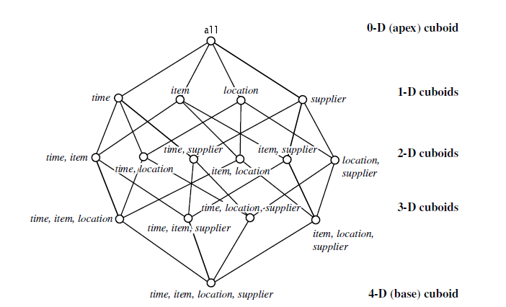
Cube: A Lattice of Cuboids
ITE-404 - Data Warehousing and Data Mining

Slide 19

Conceptual Modeling of Data Warehouses
Modeling data warehouses: dimensions & measures
  1. Star schema: A fact table in the middle connected to a set of dimension tables .
In this data warehouse contains
(1) a large central table (fact table) containing the bulk of the data, with no redundancy.
(2) a set of smaller attendant tables (dimension tables), one for each dimension.
The schema graph resembles a starburst, with the
dimension tables displayed in a radial pattern around the central fact table.
ITE-404 - Data Warehousing and Data Mining

Slide 20
Example of Star Schema
time
time_key
day
day_of_the_week
month
quarter
year
item
item_key
item_name
brand
type
supplier_type
Sales Fact Table
time_key
item_key
branch_key
branch
location
location_key
branch_key
branch_name
branch_type
location_key
street
city
state_or_province
country
units_sold
dollars_sold
avg_sales
Measures
ITE-404 - Data Warehousing and Data Mining

Slide 21
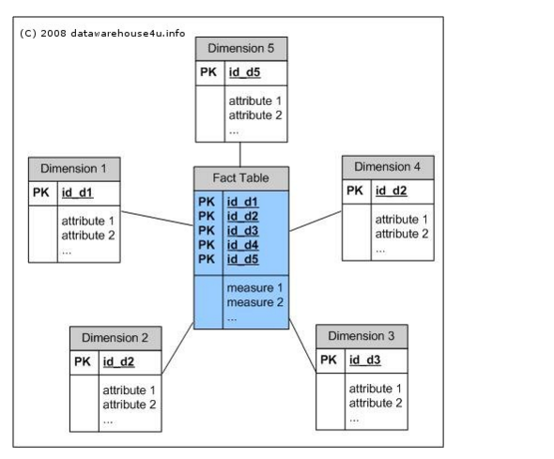
ITE-404 - Data Warehousing and Data Mining

Slide 22
What is star schema?
It is the simplest data warehouse schema.
It is called a star schema because the diagram resembles a star, with points radiating from a center.
The center of the star consists of fact table and the points of the star are the dimension tables.
Usually the fact tables in a star schema are in third normal form(3NF) whereas dimensional tables are de-normalized.
It is most commonly used nowadays and is recommended by Oracle.
ITE-404 - Data Warehousing and Data Mining

Slide 23
Fact Tables: A fact table typically has two types of columns: foreign keys to dimension tables and measures those that contain numeric facts. A fact table can contain fact's data on detail or aggregated level.
Dimension Tables: A dimension is a structure usually composed of one or more hierarchies that categorizes data. If a dimension hasn't got a hierarchies and levels it is called flat dimension or list. The primary keys of each of the dimension tables are part of the composite primary key of the fact table. Dimensional attributes help to describe the dimensional value.
Typical fact tables store data about sales while dimension tables data about geographic region (markets, cities) , clients, products, times, channels.
ITE-404 - Data Warehousing and Data Mining

Slide 24
The main characteristics of star schema:
Simple structure -> easy to understand schema
Great query effectives -> small number of tables to join Relatively long time of loading data into
dimension tables -> de-normalization, redundancy data caused that size of the table could be large.
The most commonly used in the data warehouse implementations -> widely supported by a large number of business intelligence tools
ITE-404 - Data Warehousing and Data Mining

Slide 25
  Snowflake schema: A refinement of star schema where some dimensional hierarchy is normalized into a set of smaller dimension tables, forming a shape similar to snowflake
ITE-404 - Data Warehousing and Data Mining

Slide 26
Example of Snowflake Schema
time
item
time_key
day
day_of_the_week
month
quarter
year
item_key
item_name
brand
type
supplier_key
supplier
Sales Fact Table
supplier_key
supplier_type
time_key
item_key
branch_key
branch
location
location_key
location_key
street
city_key
branch_key
branch_name
branch_type
units_sold
dollars_sold
city
city_key
city
state_or_province
country
avg_sales
Measures
ITE-404 - Data Warehousing and Data Mining

Slide 27
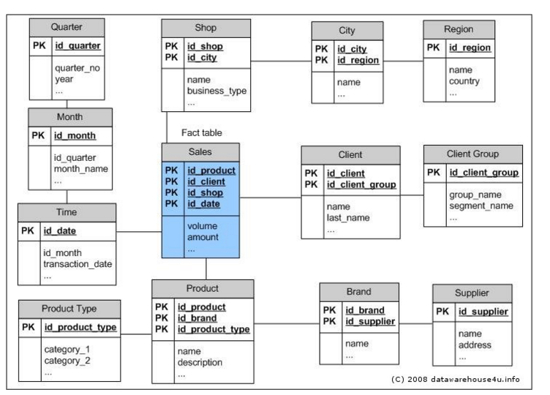
ITE-404 - Data Warehousing and Data Mining

Slide 28
  Fact constellations: Multiple fact tables share dimension tables, viewed as a collection of stars, therefore called galaxy schema or fact constellation
  For each star schema it is possible to construct fact constellation schema(for example by splitting the original star schema into more star schemes each of them describes facts on another level of dimension hierarchies).
  The fact constellation architecture contains multiple fact tables that share many dimension tables.
  The main shortcoming of the fact constellation schema is a more complicated design because many variants for particular kinds of aggregation must be considered and selected. Moreover, dimension tables are still large.
ITE-404 - Data Warehousing and Data Mining

Slide 29
Example of Fact Constellation
time
time_key
day
day_of_the_week
month
quarter
year
item
Shipping Fact Table
item_key
item_name
brand
type
supplier_type
Sales Fact Table
time_key
time_key
item_key
shipper_key
item_key
branch_key
from_location
branch
location_key
location
to_location
branch_key
branch_name
branch_type
units_sold
location_key
street
city
province_or_state
country
dollars_cost
dollars_sold
units_shipped
avg_sales
shipper
Measures
shipper_key
shipper_name
location_key
shipper_type
ITE-404 - Data Warehousing and Data Mining

Slide 30
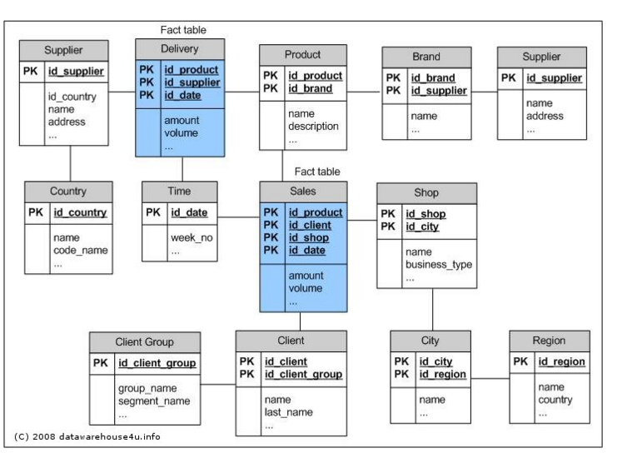

ITE-404 - Data Warehousing and Data Mining

Slide 31
data warehouse and a data mart
A data warehouse collects information about subjects that span the entire organization, such as customers, items, sales, assets, and personnel, and thus its scope is enterprise-wide.
For data warehouses, the fact constellation schema is commonly used, since it can model multiple, interrelated subjects.
A data mart, on the other hand, is a department subset of the data warehouse that focuses on selected subjects, and thus its scope is departmentwide.
For data marts, the star or snowflake schema are commonly used, since both are geared toward modeling single subjects, although the star schema is more popular and efficient.
ITE-404 - Data Warehousing and Data Mining

Slide 32
Cube Definition Syntax in Data Mining Query Language (DMQL)
Cube Definition (Fact Table)
  define cube <cube_name> [<dimension_list>]: <measure_list>
Dimension Definition (Dimension Table)
  define dimension <dimension_name> as (<attribute_or_subdimension_list>)
Special Case (Shared Dimension Tables)
  First time as “cube definition”
  define dimension <dimension_name> as <dimension_name_first_time> in cube <cube_name_first_time>
ITE-404 - Data Warehousing and Data Mining

Slide 33
Defining Star Schema in DMQL
define cube sales_star [time, item, branch, location]:
    dollars_sold = sum(sales_in_dollars), avg_sales = avg(sales_in_dollars), units_sold = count(*)
define dimension time as (time_key, day, day_of_week, month, quarter, year)
define dimension item as (item_key, item_name, brand, type, supplier_type)
define dimension branch as (branch_key, branch_name, branch_type)
define dimension location as (location_key, street, city, province_or_state, country)
ITE-404 - Data Warehousing and Data Mining

Slide 34
Defining Snowflake Schema in DMQL
define cube sales_snowflake [time, item, branch, location]:
    dollars_sold = sum(sales_in_dollars), avg_sales = avg(sales_in_dollars), units_sold = count(*)
define dimension time as (time_key, day, day_of_week, month, quarter, year)
define dimension item as (item_key, item_name, brand, type, supplier(supplier_key, supplier_type))
define dimension branch as (branch_key, branch_name, branch_type)
define dimension location as (location_key, street, city(city_key, province_or_state, country))
ITE-404 - Data Warehousing and Data Mining

Slide 35
Defining Fact Constellation in DMQL
define cube sales [time, item, branch, location]:
    dollars_sold = sum(sales_in_dollars), avg_sales = avg(sales_in_dollars), units_sold = count(*)
define dimension time as (time_key, day, day_of_week, month, quarter, year)
define dimension item as (item_key, item_name, brand, type, supplier_type)
define dimension branch as (branch_key, branch_name, branch_type)
define dimension location as (location_key, street, city, province_or_state, country)
define cube shipping [time, item, shipper, from_location, to_location]:
    dollar_cost = sum(cost_in_dollars), unit_shipped = count(*)
define dimension time as time in cube sales
define dimension item as item in cube sales
define dimension shipper as (shipper_key, shipper_name, location as location in cube sales, shipper_type)
define dimension from_location as location in cube sales
define dimension to_location as location in cube sales
ITE-404 - Data Warehousing and Data Mining

Slide 36
Measures of Data Cube: Three Categories
Distributive: if the result derived by applying the function to n aggregate values is the same as that derived by applying the function on all the data without partitioning
    E.g., count(), sum(), min(), max()
Algebraic: if it can be computed by an algebraic function with M arguments (where M is a bounded integer), each of which is obtained by applying a distributive aggregate function
    E.g., avg(), min_N(), standard_deviation()
Holistic: if there is no constant bound on the storage size needed to describe a subaggregate.
    E.g., median(), mode(), rank()
ITE-404 - Data Warehousing and Data Mining

Slide 37
Multidimensional Data
Sales volume as a function of product, month, and region
Dimensions: Product, Location, Time
Hierarchical summarization paths
Region
Industry Region Year
Category Country Quarter
Product City Month Week
Office Day
Product
Month
ITE-404 - Data Warehousing and Data Mining

Slide 38

A Sample Data Cube
Date
Total annual sales
of TV in U.S.A.
1Qtr
2Qtr
3Qtr
4Qtr
sum
Product
TV
PC
U.S.A
VCR
sum
Canada
Country
Mexico
sum
All, All, All
ITE-404 - Data Warehousing and Data Mining

Slide 39
Cuboids Corresponding to the Cube
all
0-D(apex) cuboid
product
date
country
1-D cuboids
product,date
product,country
date, country
2-D cuboids
3-D(base) cuboid
product, date, country
ITE-404 - Data Warehousing and Data Mining

Slide 40

Browsing a Data Cube
Visualization
OLAP capabilities
Interactive manipulation
ITE-404 - Data Warehousing and Data Mining

Slide 41
Typical OLAP Operations
Roll up (drill-up): summarize data
  by climbing up hierarchy or by dimension reduction
Drill down (roll down): reverse of roll-up
  from higher level summary to lower level summary or detailed data, or introducing new dimensions
Slice and dice: project and select
Pivot (rotate):
  reorient the cube, visualization, 3D to series of 2D planes
Other operations
  drill across: involving (across) more than one fact table
  drill through: through the bottom level of the cube to its back-end relational tables (using SQL)
ITE-404 - Data Warehousing and Data Mining

Slide 42

Fig. 3.10 Typical OLAP Operations
ITE-404 - Data Warehousing and Data Mining

Slide 43
A Star-Net Query Model
consists of four radial lines, representing concept hierarchies for the dimensions location, customer, item, and time, respectively.
Each line consists of footprints representing abstraction levels of the dimension.
For example, the time line has four footprints: “day,” “month,” “quarter,” and “year.”
ITE-404 - Data Warehousing and Data Mining

Slide 44
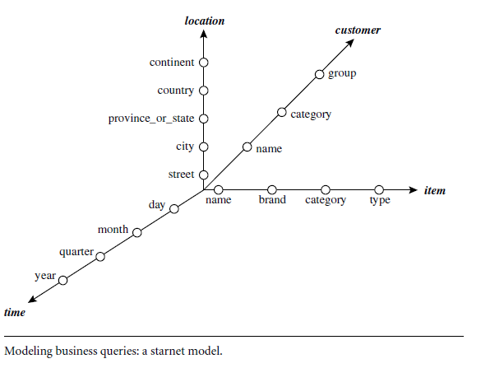
A Star-Net Query Model
ITE-404 - Data Warehousing and Data Mining

Slide 45
A Star-Net Query Model
Customer Orders
Shipping Method
Customer
CONTRACTS
AIR-EXPRESS
ORDER
TRUCK
PRODUCT LINE
Time
Product
ANNUALY
QTRLY
DAILY
PRODUCT ITEM
PRODUCT GROUP
CITY
SALES PERSON
COUNTRY
DISTRICT
REGION
DIVISION
Location
Each circle is called a footprint
Promotion
Organization
ITE-404 - Data Warehousing and Data Mining

